Slide 1
WIFI
MUTEK_ESPACEPRO
password: 88mutek99
DOWNLOAD THE FOLDER FROM THIS LINK…
www.bit.do/muteksc

Slide 2
INTRODUCTION TO LIVE CODING
Monument National, Montréal
23.08.2018 11:00–13:00
w/ Joanne Armitage and Shelly Knotts
SUPERCOLLIDER | SYNTHESIS | PATTERNS

Slide 3
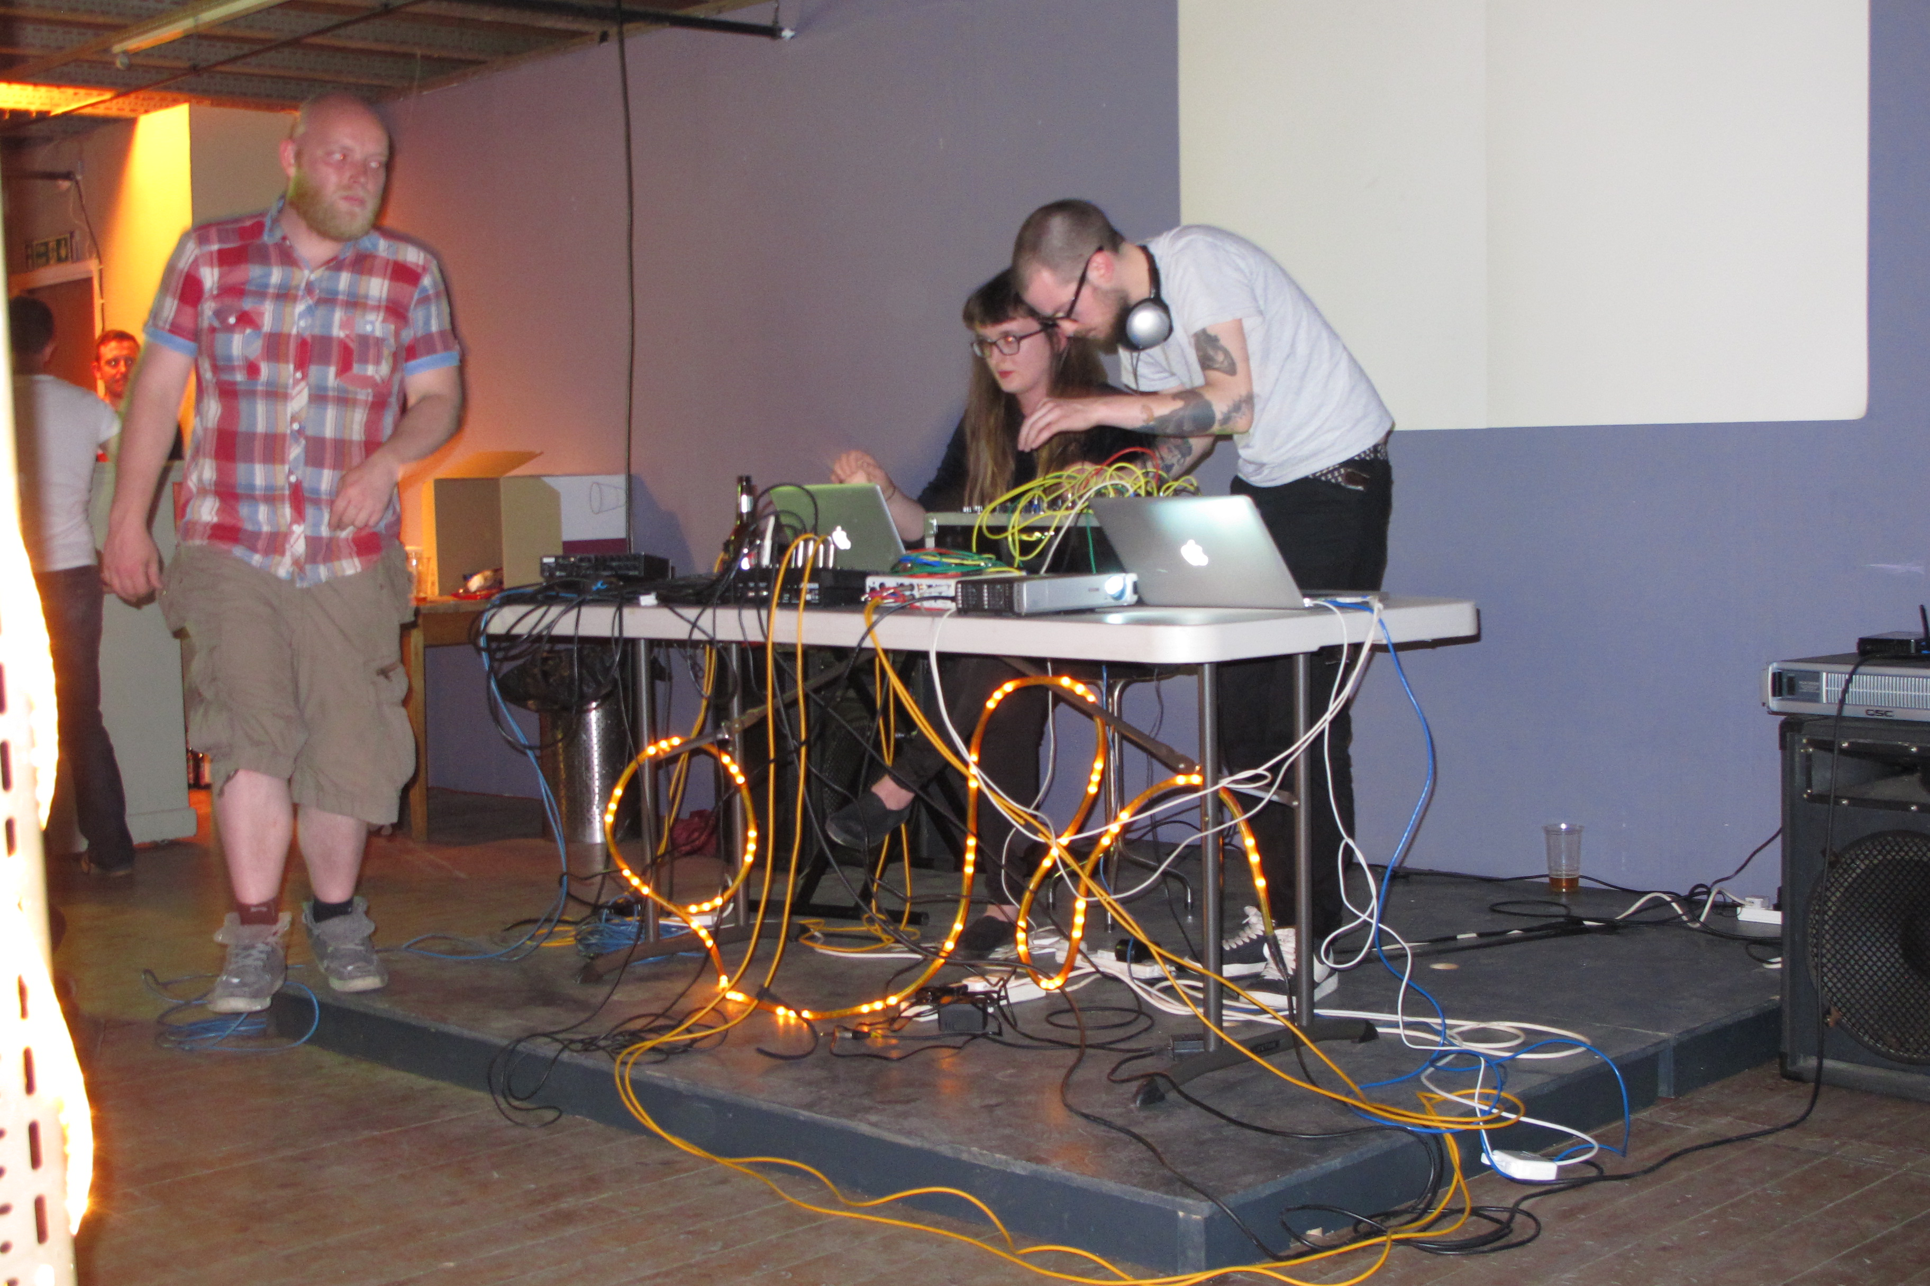
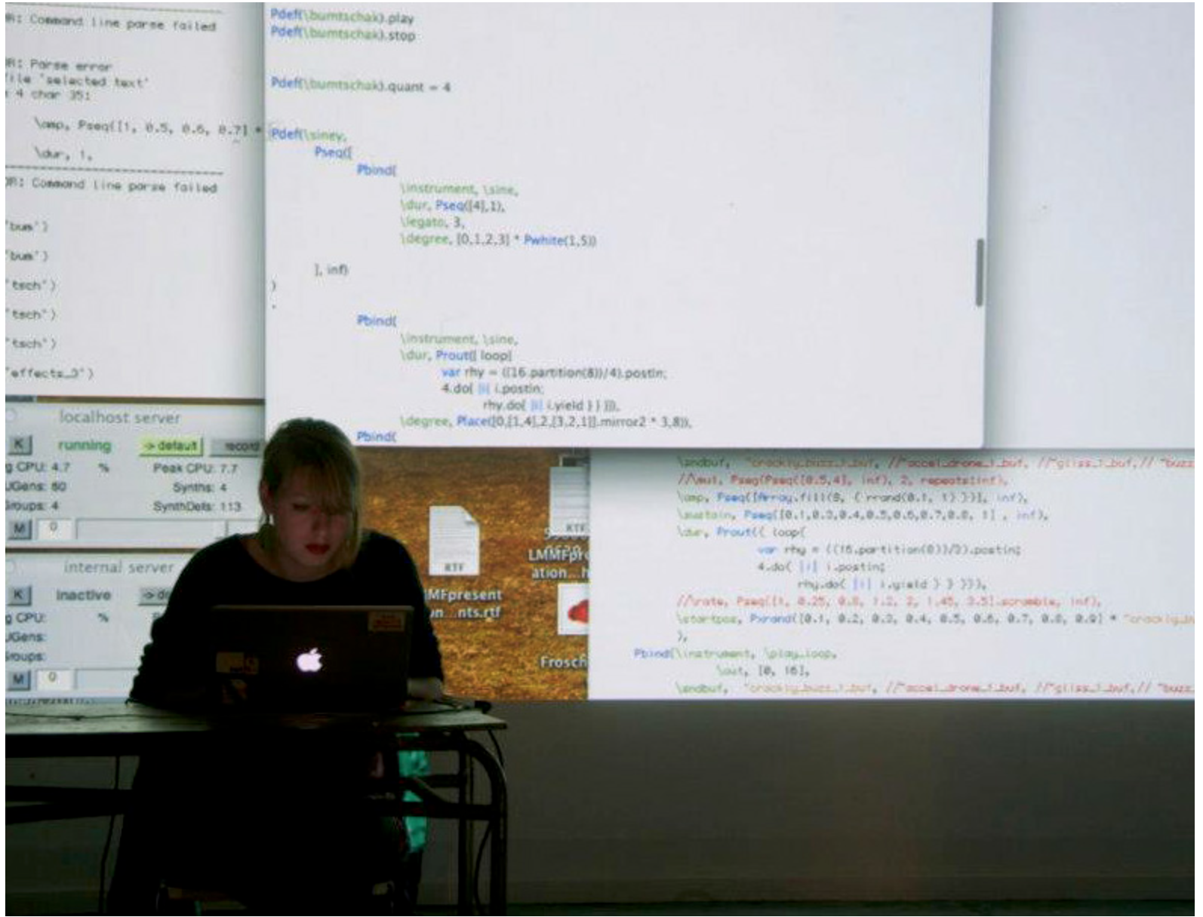
LIVE CODING
Notes:
How we got into it feelings and experiences from first gig
How our practices grew a bit
Algorave: https://www.theguardian.com/music/2017/nov/30/is-algorave-the-future-of-dance-music-sheffield-algomech-festival
https://youtu.be/kB1py_izYiM?t=9m7s

Slide 4
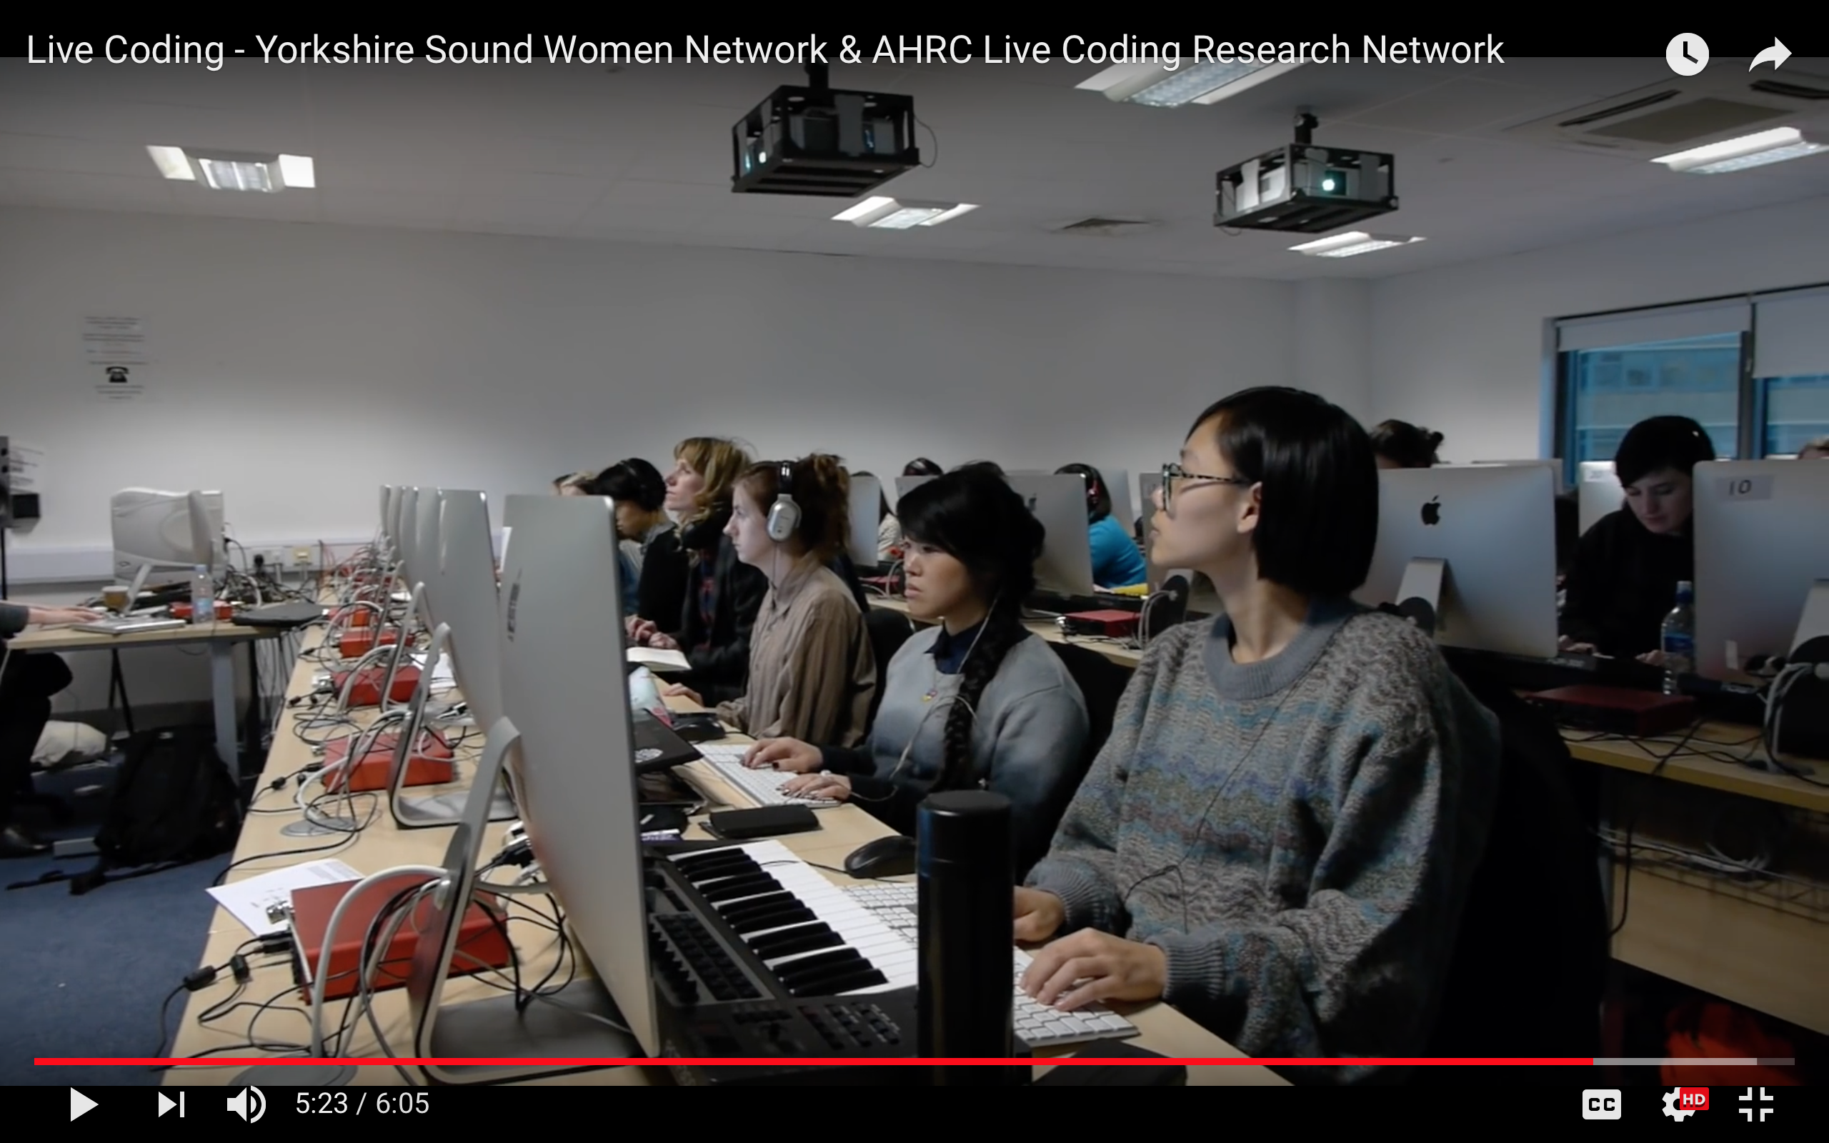
OPENING UP
Notes:
JA
Workshop
Mentoring women
https://www.youtube.com/watch?v=RpzEzUCgVoQ

Slide 5
ALGOBABEZ
Notes:
SK
How collabration formed

Slide 6
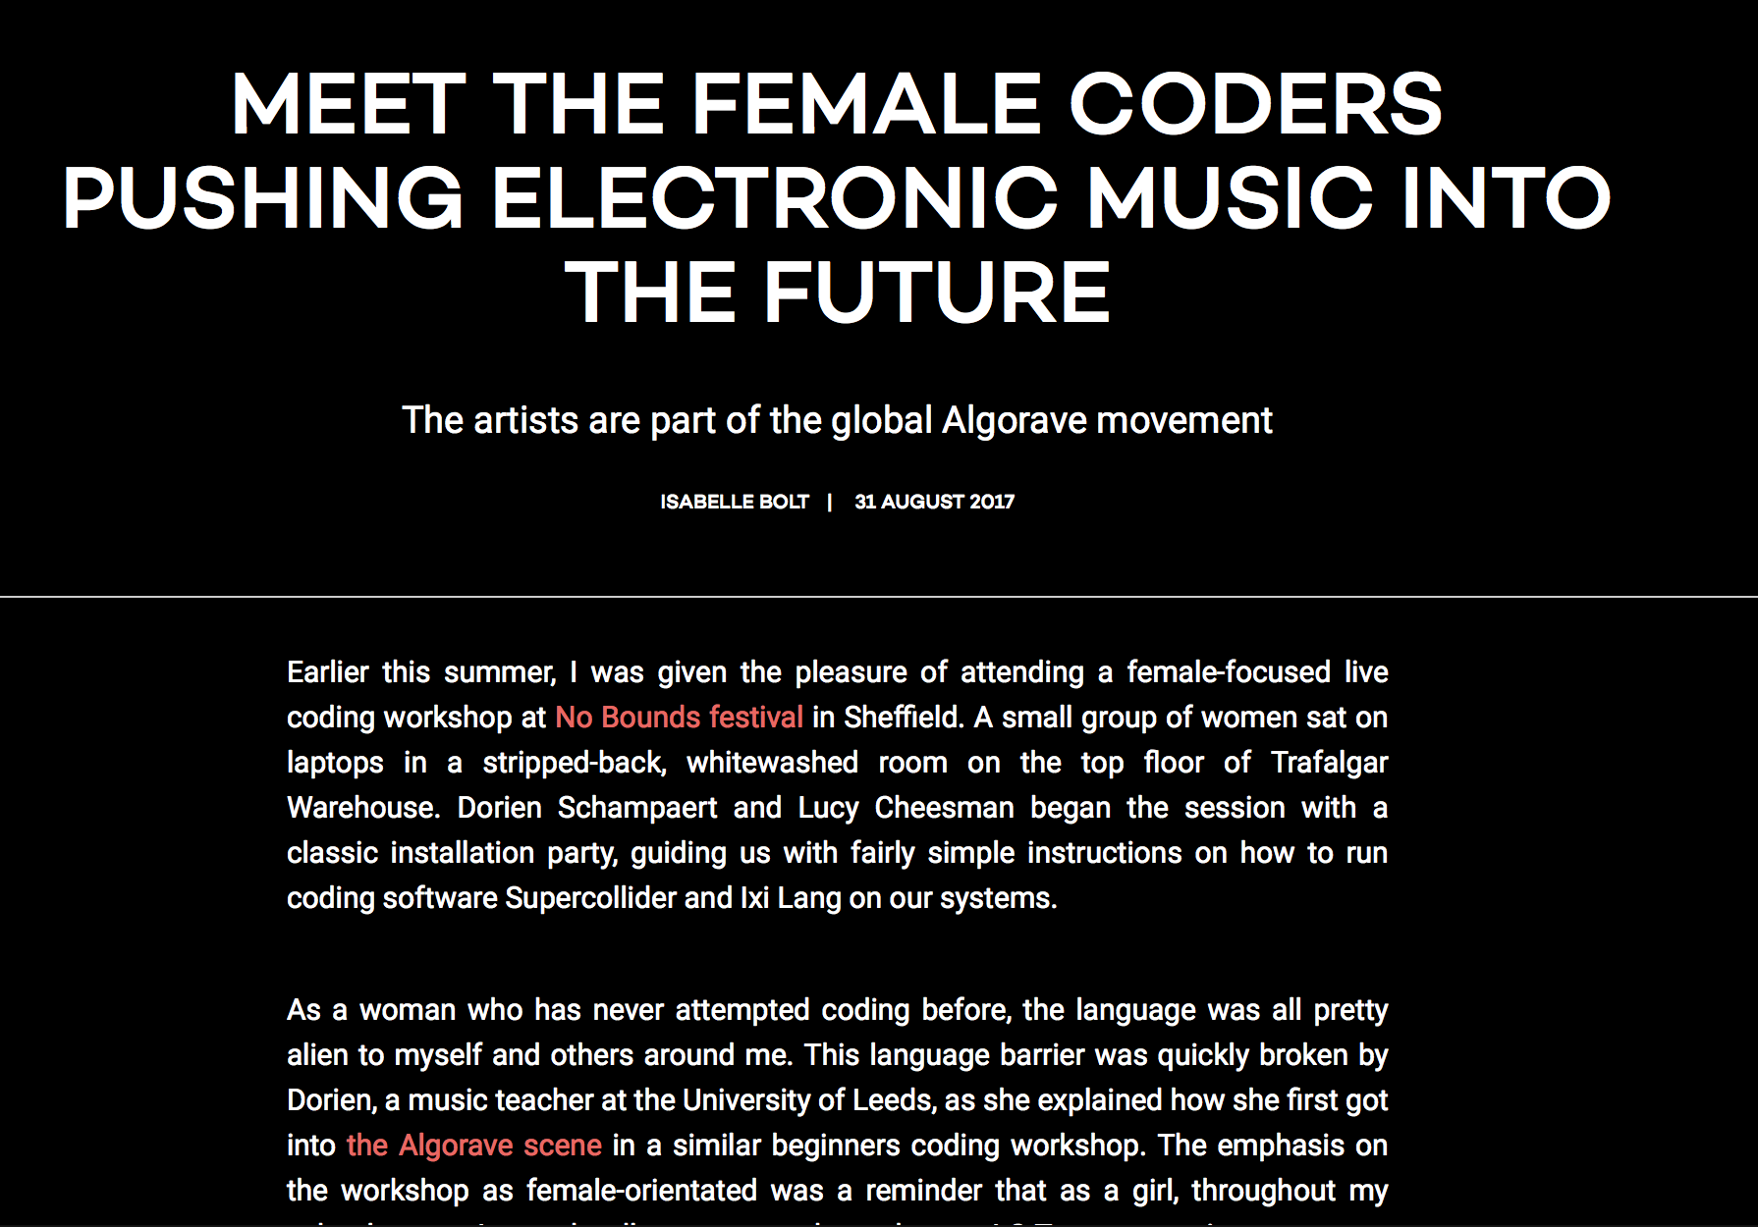
LIVE CODING WOMEN
Notes:
JA
Then we find headlines like this…
Not the future of music.
Acknowledgment of labour yet misrepresentation of the structures and how our labour is valued in the community

Slide 7

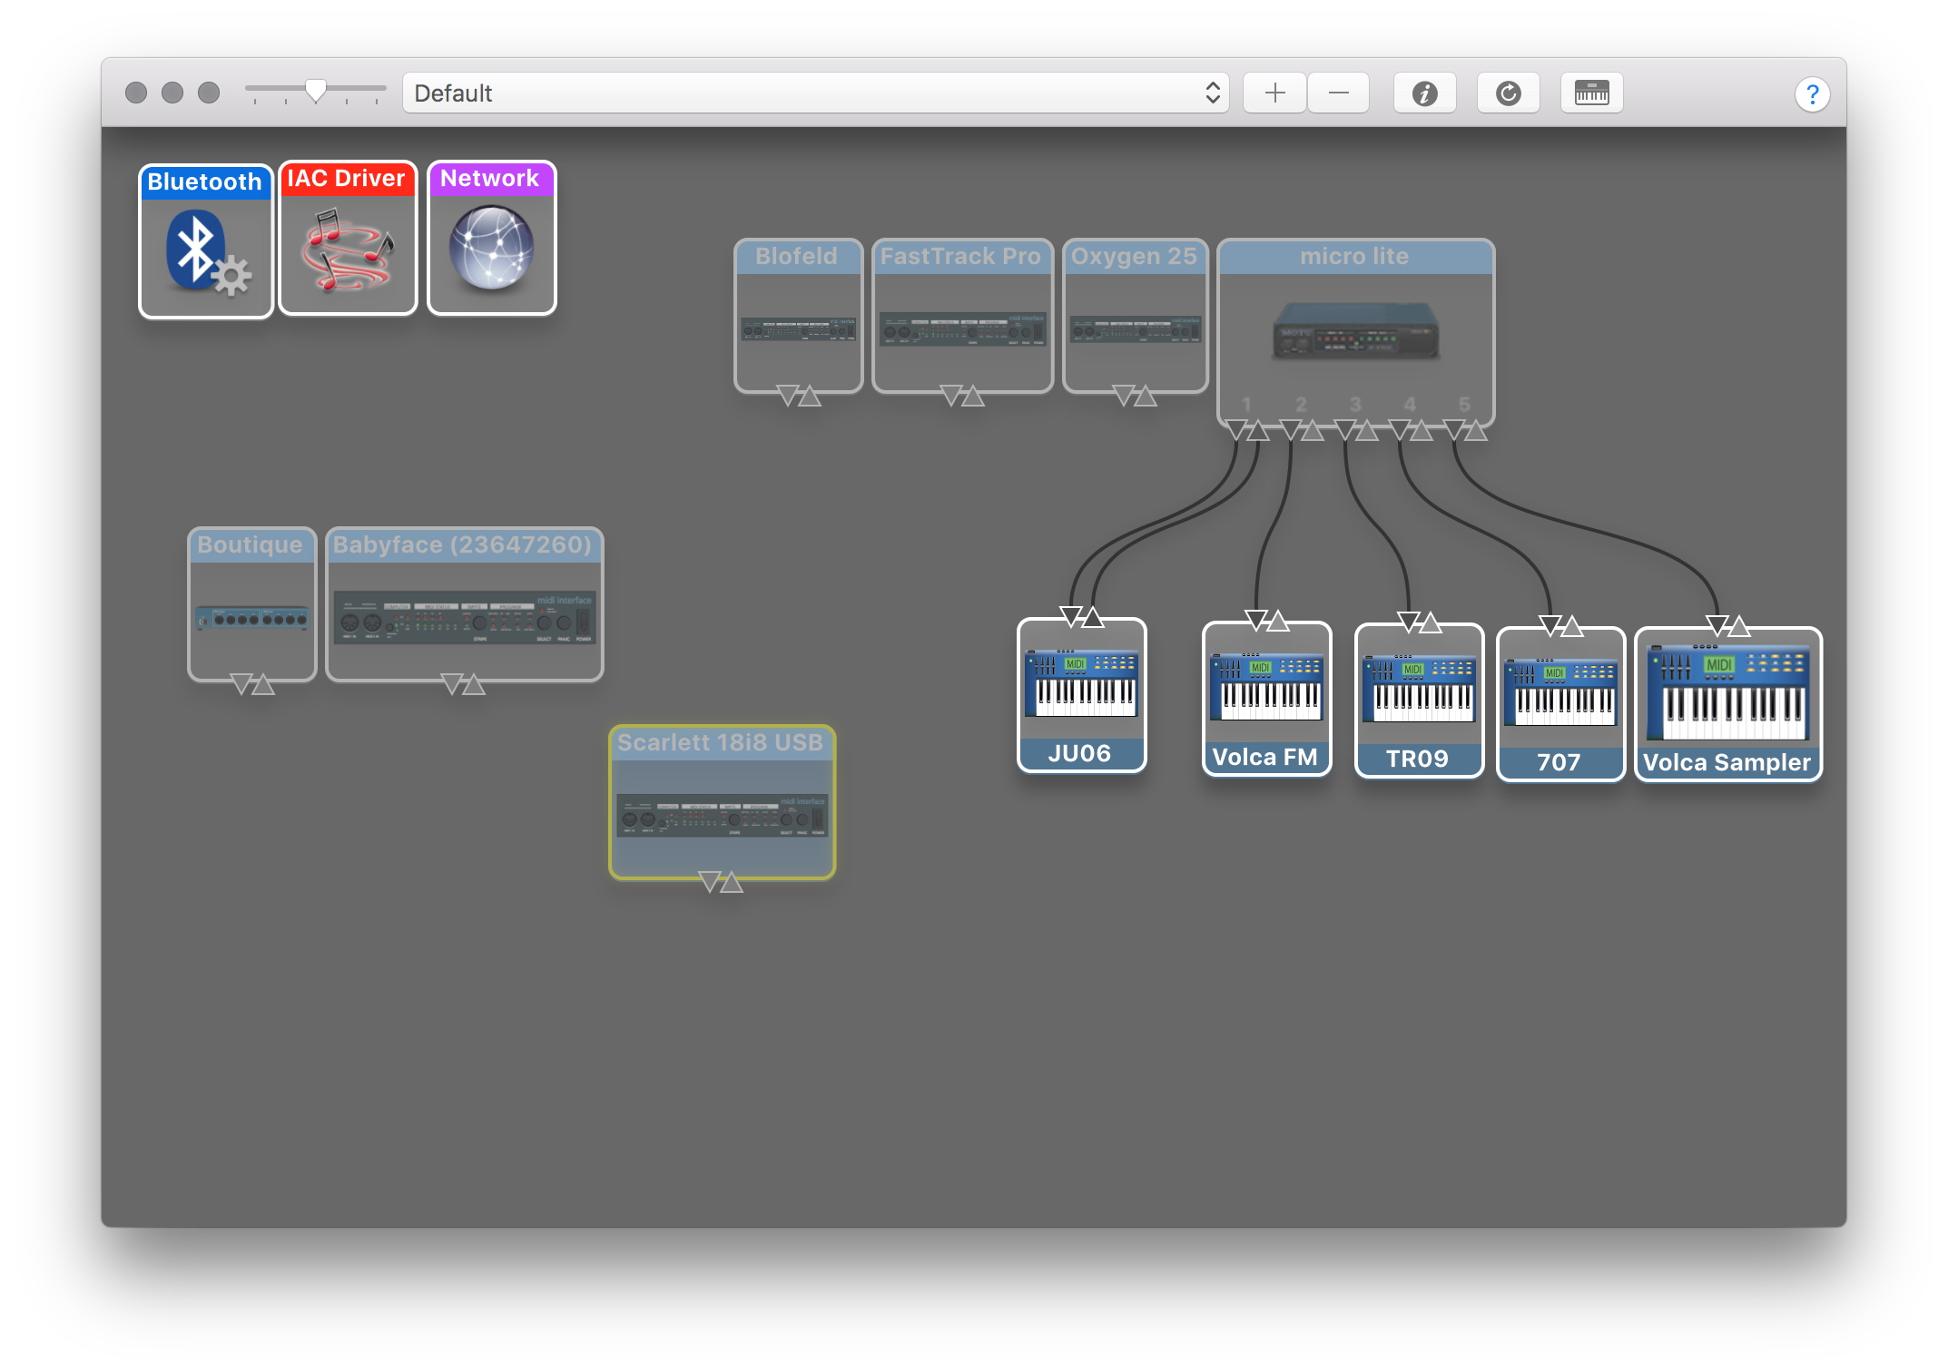
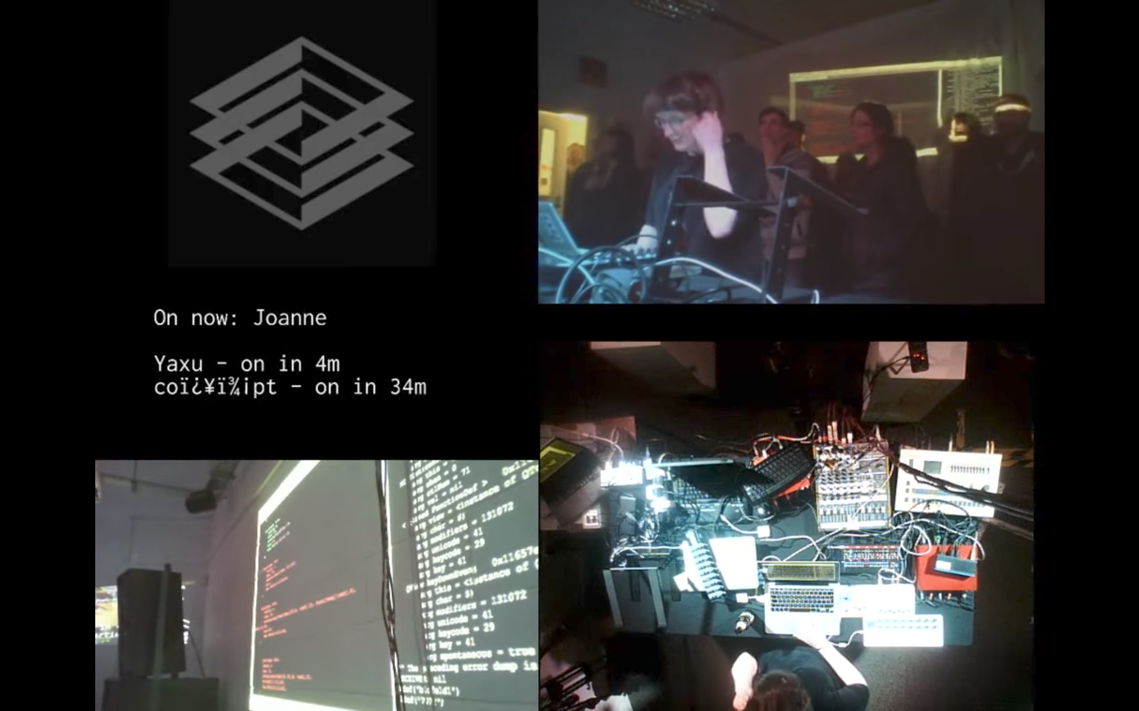
OUR SETUP
Notes:
Joint

Slide 8
CAN YOU EVEN CODE?
Algoraver 2: I’d been given the opportunity a few years back to take part in [an introductory SQL programming course], but didn’t really think I had the ability to really understand it.
Algoraver 4: I was able to create a quick simple techno track after an hour or so of learning ixi lang, which was so satisfying.
[I] really didn't know coding could be used for fun until then ( . . . ) I could understand how people used it to retrieve data etc., but that was about it ( . . . ) I think it’s made me realise that with understanding just the basics you can make things happen.

Slide 9
CODING AND THE SOCIAL
Algoraver 1: [The social is] a really important aspect of it for me actually, I’ve met so many people through live coding.
Algoraver 4: I guess I like hanging around those people, and they create a supportive environment for me. If they weren't so encouraging of beginners, I wouldn't be here. ( . . . ) I think that the Algorave/live coding environment is a really stimulating one overall, that just welcomes people of all levels and lets them do whatever they want, really.
Notes:
SK--- Algorave communcal spaces. Mexican practices

Slide 10
(ACTUALLY) PERFORMING CODE
Algoraver 6: I wasn't going to perform, like, ever, but [someone] convinced me to, and I am glad I did! ( . . . ) I could never picture myself making anything anybody would want to see. I never thought I would enjoy performing, but I really really ended up doing so!
Notes:
Performance opportunities
How to support artists into the scene we love noobs, opening shows low pressure (as pos) and supportive vibes.
Informal mentoring
Give people gigs, help them out
V informal
Interested in looking at how to better support artists development post-noob

Slide 11
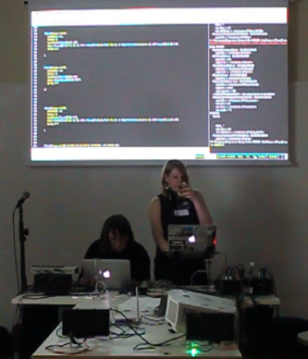
FAILING
(& drinking through it)
Notes:
SK

Slide 12




OTHER APPROACHES
For a more comprehensive list of environments:
http://toplap.org/wiki/ToplapSystems
Notes:
How we got into it

Slide 13
WORKSHOP STRUCTURE
11:00–11:30 INTRODUCTIONS + IXI INTRO
11:30–12:00 INTRO TO SYNTHESIS
12:00–12:10 MEXICAN ROULETTE
12:10–12:40 INTRO TO PATTERNS + MIDI
12:40–13:00 JAM

Slide 14
FILES
mutek_intro.pptx
Mutek_MTL.scd
mutek_p1.scd
mutek_p2.scd

Slide 15
IXILANG
JAM
Notes:
Joanne write precode to control your Blofeld and we can see what happens.

Slide 16
INTERFACING WITH MIDI
This could be achieved with the following:
Soundcard via USB
A dedicated MIDI unit
Direct to synth via USB
A USB–MIDI convertor cable
Virtual MIDI (if using VST)
Notes:
So how do we get SuperCollider and our synthesizers to talk to eachother using MIDI?
I’ve had issues sending large amounts of MIDI data via USB before….
Virtual MIDI—on Mac there is the IAC driver (inter application communicator), one or more MIDI bus to send between different softwares

Slide 17
MIDI ROUTING
MAC USERS: Audio MIDI Setup
WINDOWS USERS: Sounds and Audio Devices
LINUX USERS: ALSA (need to download)
Notes:
On Windows, all
MIDI devices which are installed correctly on your system and appear in the Sounds and Audio Devices Properties (Start > Settings > Sounds and Audio Devices)
https://www.alsa-project.org/main/index.php/Main_Page

Slide 18
CONNECT TO SYNTH
Unless your synth can connect via USB
You need to connect the MIDI OUT port of your interface to the MIDI IN port of your synth.
Notes:
On Windows, all
MIDI devices which are installed correctly on your system and appear in the Sounds and Audio Devices Properties (Start > Settings > Sounds and Audio Devices)
https://www.alsa-project.org/main/index.php/Main_Page

Slide 19
SEARCH FOR SYNTH MIDI MAPPINGS
Go online and see if you can find a MIDI chart for your synth online.
Don’t worry if not—we can work it our in SuperCollider also.

Slide 20
OPEN
p1midi.scd

Slide 21
CONTACT
JOANNE ARMITAGE EMAL: midigirl1990@gmail.com WEBSITE: joannnne.github.io TWITTER: @joannnne
SHELLY KNOTTS
EMAL: knotts.shelly@gmail.com WEBSITE: datamusician.net TWITTER: @shelly_knotts

